Slide 1
Microservices and DevOps
Scalable Microservices
Microservices – the Extended Edition
Henrik Bærbak Christensen

Slide 2
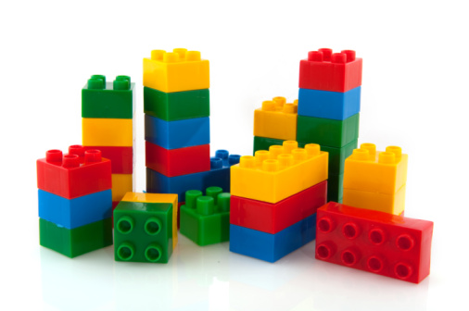
Software Reuse
If only we could build software from reusable components
A big struggle throughout
the history of computing

Slide 3
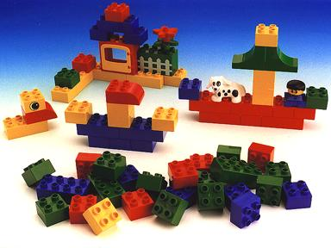
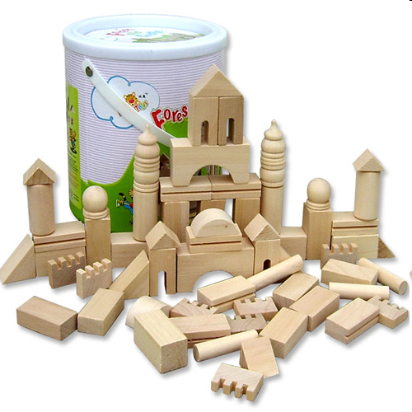
Software Reuse
During the early 90’ies the Lego bricks metaphor was often used for object/component reuse
However, the golden future of a world wide component market place sort of deflated
Vendor Lock-in
Clemens Szyperski (2002). Component Software: Beyond Object-Oriented Programming.
Notes:
If the kids want to build a large model, adding non-lego bricks does not help! It is basically a vendor lock-in!

Slide 4
Software Reuse
In the 00’ the web exploded and allowed a different deployment model
  Component based reuse:
    A static / module viewpoint - get a DLL/jar file
    “libraries” in [Lewis et al. 2014]
      Linked in, and called by in-memory function calls
  Service oriented architecture:
    A dynamic / C&C viewpoint - connect to a service
    “services” in [Lewis et al. 2014]
      Out-of-process, communicate using RPC or web service

Slide 5
SOA
Wikipedia
  A service-oriented architecture (SOA) is an architectural pattern in computer software design in which application components provide services to other components via a communications protocol, typically over a network. The principles of service-orientation are independent of any vendor, product or technology.
MacKenzie et al., 2006
  is a paradigm for organizing and utilizing distributed capabilities that may be under the control of different ownership domains
  provides a uniform means to offer, discover, interact with and use capabilities to produce desired effects consistent with measurable preconditions and expectations

Slide 6
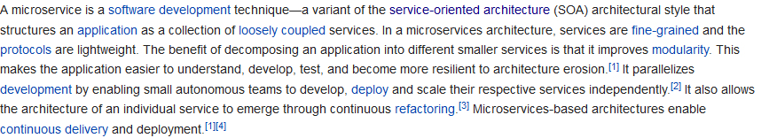
Microservices
The next step? A successful step?
Wikipedia (2018)
Keywords
  Loosely coupled, fine-grained, lightweight protocols, autonomous teams, independent deployment and scaling, continuous delivery.

Slide 7
So – Our Take
We will look at two takes on the concept...
  James Lewis and Martin Fowler
  Sam Newman
And compare ☺

Slide 8
Lewis and Fowler

Slide 9
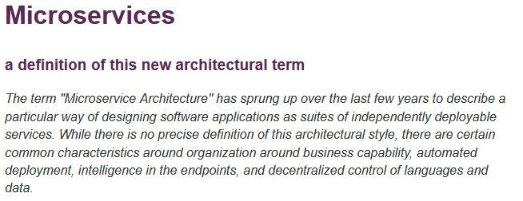
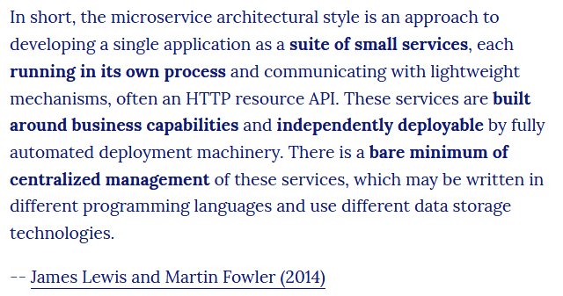
Micro Services
The next step? A successful step?

Slide 10
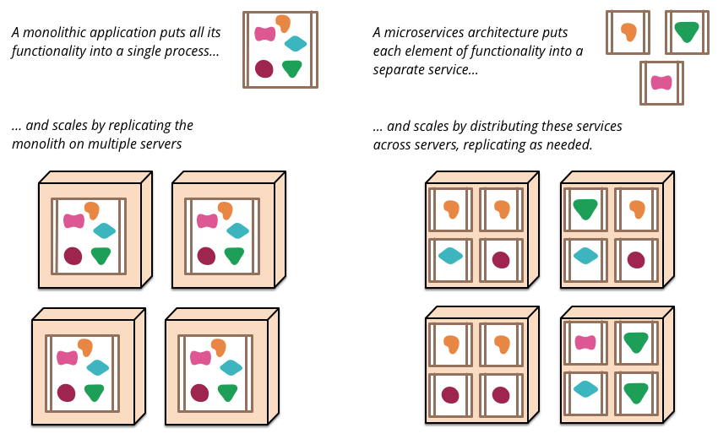
Overview

Slide 11
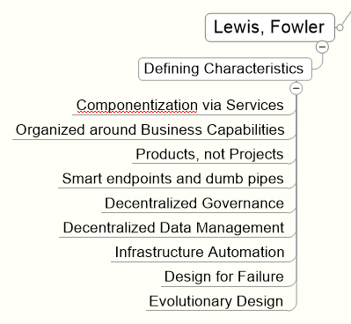
Key Properties

Slide 12
Component = Service
Component = unit of software that is independently replaceable and upgradeable...
Services are the components of a microservice arch.
  Out-of-process, communicate using RPC or web service
  Independently deployable
    I.e. smaller units of deployment
  Explicit interface
    Leads to lower coupling
Service is not necessarily single process…
  Often it is (app+db) deployed together…

Slide 13
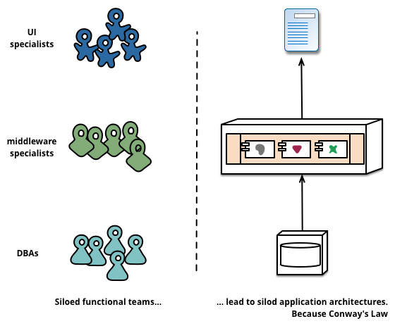
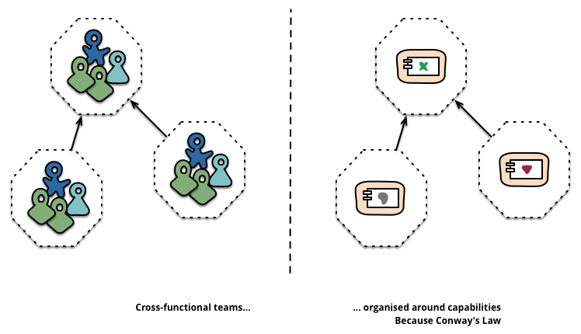

Organized around Business
Classic Organization
Microservice Organization

Slide 14
Products, not Projects
Classic project organization
  Develop piece of software, upon completion, hand over to maintenance, project dissolve...
Product organization
  You build it, you run it
    That is the team designs, builds, tests, deploys, and maintains it...
  Full lifecycle ownership

Slide 15
Smart endpoints, dumb pipes
The logic lives in the services, not in the communication
  CC viewpoint: Smart Components, dumb Connectors
  Opposite:
    Enterprise service bus
      Allows filtering, processing, of messages while being transmitted
Typical message protocols
  HTTP / REST Api’s
  Lightweight messaging
    RabbitMQ, etc., with no message processing
  GraphQL (?)

Slide 16
Decentralized Governance
Choice of language and technology stack is open
  Use C++ for that performant service; choose Node.js for a reports service
  Opposite: Company-wide adoption of Microsoft tech stack
Often companies adopt building useful tools for other teams with similar problems
Often companies do restrict tech stack though
  Netflix (as I recall) insists on JVM based tech stack only

Slide 17
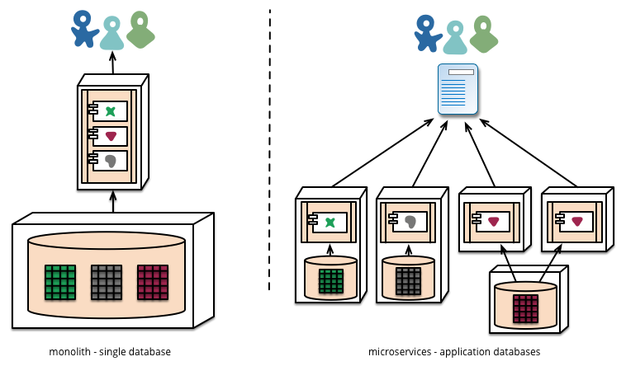
Decentralized Data Management
Is decentralized
  Each service has its own storage

Slide 18
Decentralized Data Management
Is decentralized
  Each service has its own storage
Mandatory Note!
Last time, no one did this ☹
Notes:
Last instance of the course, all microservices reused the same underlying storage tier, invalidating the paradigm somewhat. The DB became single-point of failure

Slide 19
Decentralized Data Management
Transaction handling is highly difficult in such a context
Emphasis is on
eventual consistency
SAGA pattern
My humble opinion
  If you need transactions, why not use a DB that supports it?

Slide 20
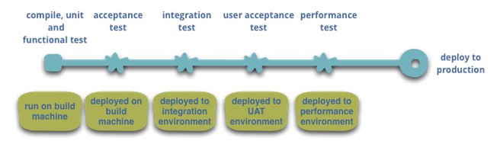
Infrastructure Automation
Continous Delivery
  Deployment Pipeline: An automated implementation of your application’s build, deploy, test, and release process.
Agile Manifesto:
Highest priority is to satisfy the customer through early and continuous delivery of valuable software.

Slide 21
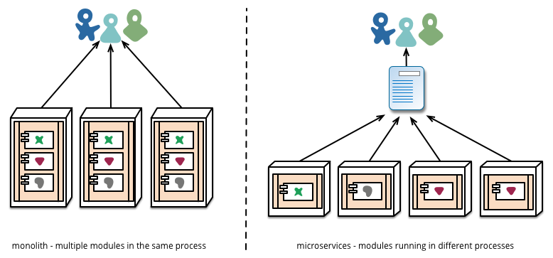
Infrastructure Automation
One repo / multiple repos ?

Slide 22
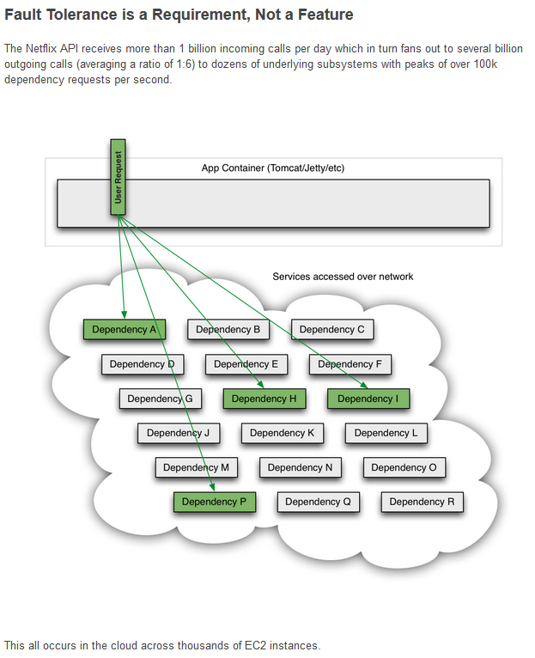
… And Design for Failure!
Circuit Breakers
Timeouts
Bulkhead
Nygard: Every remote call is an integration point. Every integration point must be guarded to allow safe failure modes.

Slide 23
Evolutionary Design
Key property of a component is the notion of independent replacement and upgradeability.
Build replaceable and upgradeable units, give opportunity for more granular release planning
Evolution through replacing/scraping individual service rather than big replacements of whole monolith

Slide 24
Newman

Slide 25
Definition
Newman’s groundbreaking and highly precise definition.
Microservices are small,
autonomous services that work together.
Budd (2002)

Slide 26
Defining Characteristics
Small, focused on doing one thing well
  Service boundaries are business boundaries
  Explicit boundaries (out-of-process communication)
  Small enough and no smaller
    Boundary: team size, rewrite time
Autonomous
  Separate entity
  Communication is network calls (avoid tight coupling) (hm...)
  Expose API (technology-agnostic)
  Decoupling: can I change this service without changing any other?

Slide 27
Key Benefits
Technological Heterogenity
  Each service may use its own technology stack
    Pick the right tool for each job
  May choose data storage techology independently
  Quick technology adaption
    Lower risk by selecting new technology for given service
  Counterpoint
    Overhead in maintaining many technologies
    Company ‘Technology Decisions’ may restrict that
      NetFlix and Twitter: Only JVM based systems

Slide 28
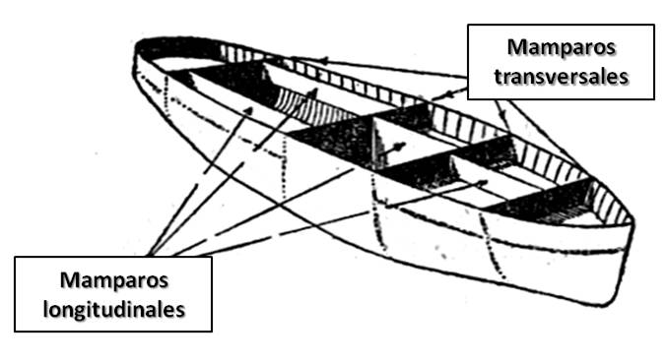
Key Benefits
Resilience
  Nygard (2017) pattern: Bulkhead
  Bulkhead: Partitioning a system so
  failures in one part does not lead to system failure
  Handle failure of services and degrade functionality accordingly
  Counterpoint
    Highly distributed systems have a lot of failure modes that needs to be addressed
    Nygard’s book contains essential hard-earned tactics…

Slide 29
Key Benefits
Scaling
  Just scale the microservice that needs scaling
    Opposite monolith system: all things scale together
  Utilize on-demand provisioning of VMs to scale automatically
Ease of Deployment
  A one-line bug fix in one service only means one service to redeploy
    And rollback is also much easier
    Opposite monolith system: full redeployment of monolith
      Fear of breaking stuff => changes accumulate

Slide 30
Key Benefits
Organization Alignment
  Small teams on small service – align organization and architecture
    Smaller teams on smaller code bases are more efficient
Composability
  Functionality consumed in different ways for different purposes
    Uhum… I am a bit skeptical…
Optimizing for Replacability
  Out of date services are easier to replace because its small size
    Opposite: That monster COBOL system everybody is afraid of...

Slide 31
Comparison
Lewis vs Newman

Slide 32
Overview

Slide 33
Comparing
Wikipedia keywords:
  Loosely coupled, fine-grained, lightweight protocols, autonomous teams, independent deployment and scaling, continuous delivery.

